Slide 1
Design Patterns - STATE
Bhavik Gujarati
Sandeep Alajangi

Slide 2
Roadmap
Types of Design Pattern
What?
When?
How?
Example
Exercise
Advantages and Disadvantages
State vs Strategy

Slide 3
Types of Design Patterns
Creational Design Pattern
Provides a way to create objects while hiding the creation logic
Example: Builder Pattern
Structural Design Pattern
Forms large object structures between many disparate objects
Example: Adapter Pattern
Behavioral Design Pattern
Manages algorithms, relationships, and responsibilities between objects
Example: Strategy Pattern

Slide 4
STATE

Slide 5
What?
Allows an object to alter its behaviour when its internal state changes
A Behavioral Design Pattern
we create objects which represent various states and a context object whose behavior varies as its state object changes

Slide 6
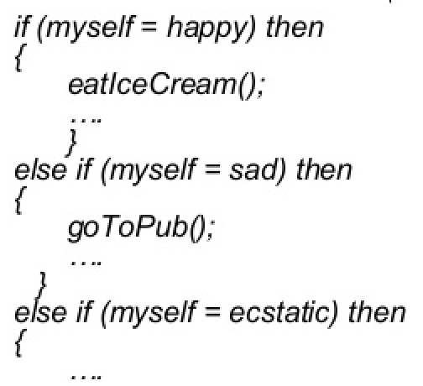
When?
When object can be in one of the several states, with different behaviour in each state
To simplify operations that have large conditional statements that depend on object’s state

Slide 7
How?
Context
Interface to the outside world
Answer of “Whose state are we talking about?”
State
A skeleton for different states
Interface or Abstract class
Concrete classes
Represents actual nature of the states
Implements/extends “State”

Slide 8
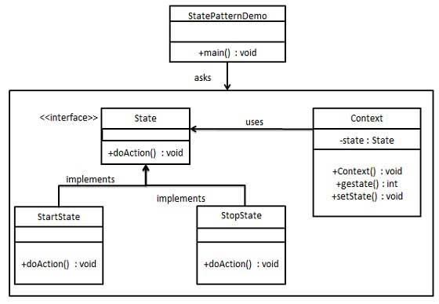

Slide 9

Example
Consider a Ceiling Fan with 4 states: Off, Low, Medium, High
It has one method pull to transit to next state.
How would have we gone about it if we did not know about state pattern?

Slide 10
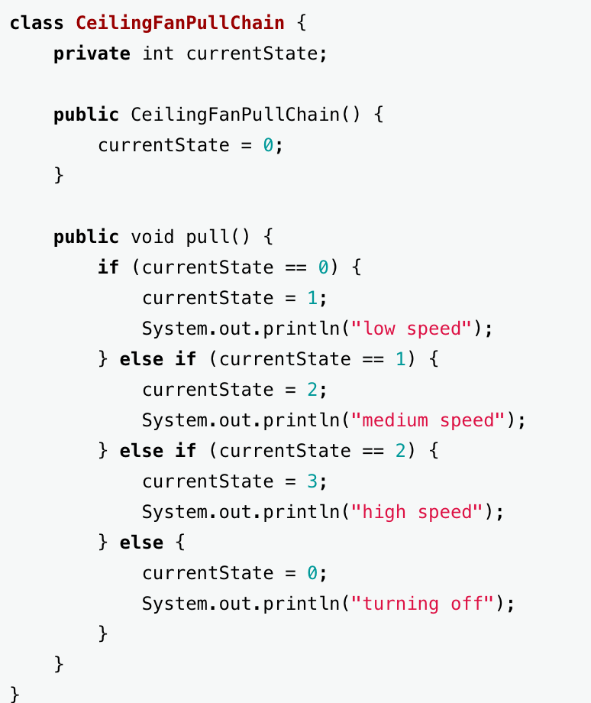
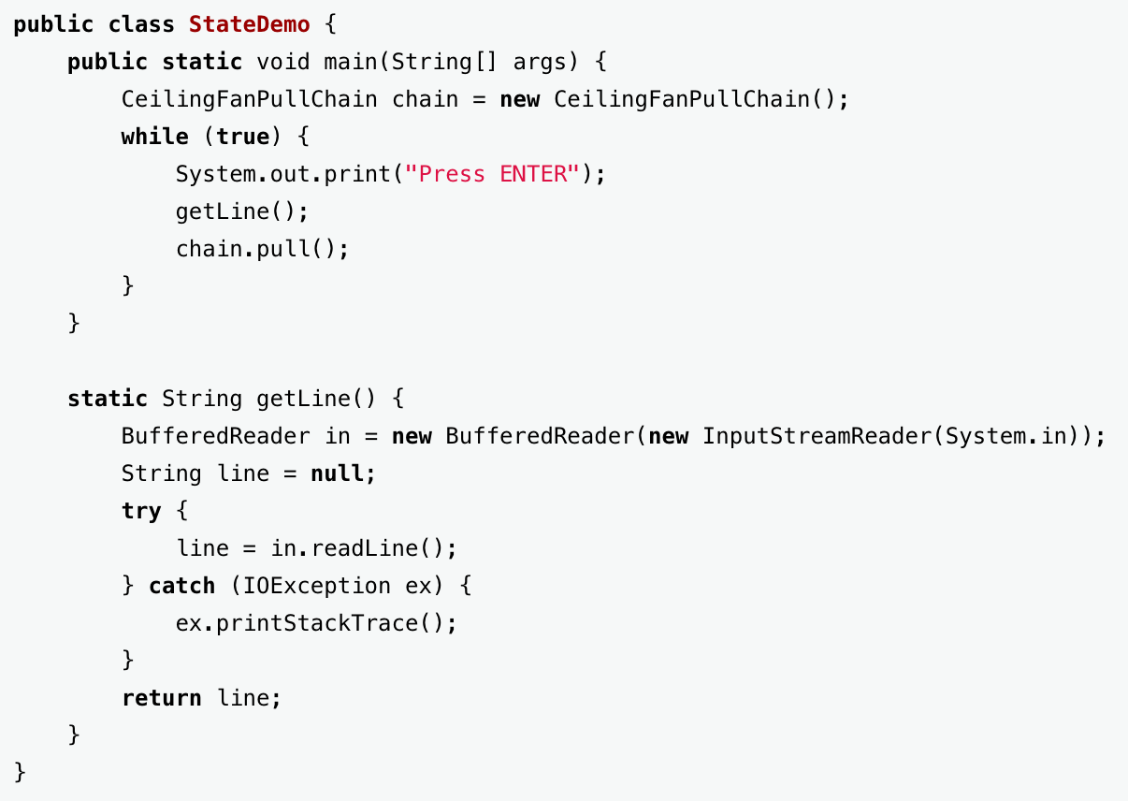

Slide 11

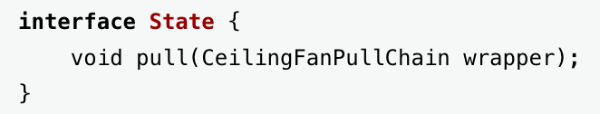
Now, With State Pattern

Slide 12
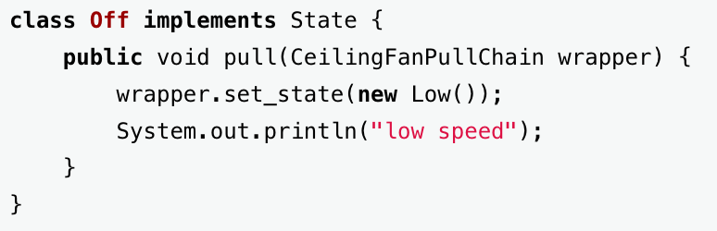
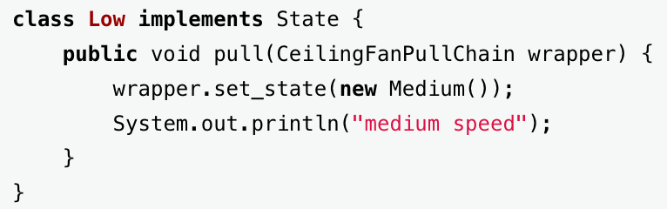

Slide 13
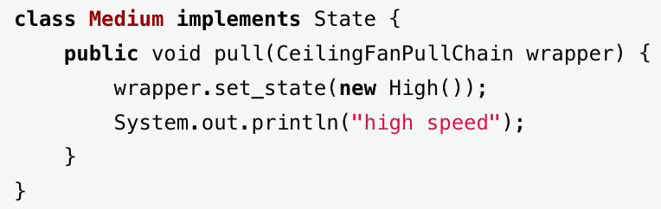
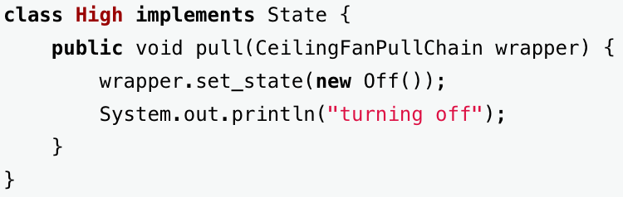

Slide 14
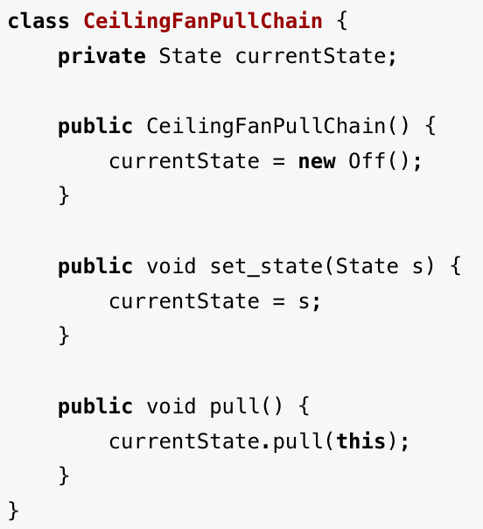

Slide 15
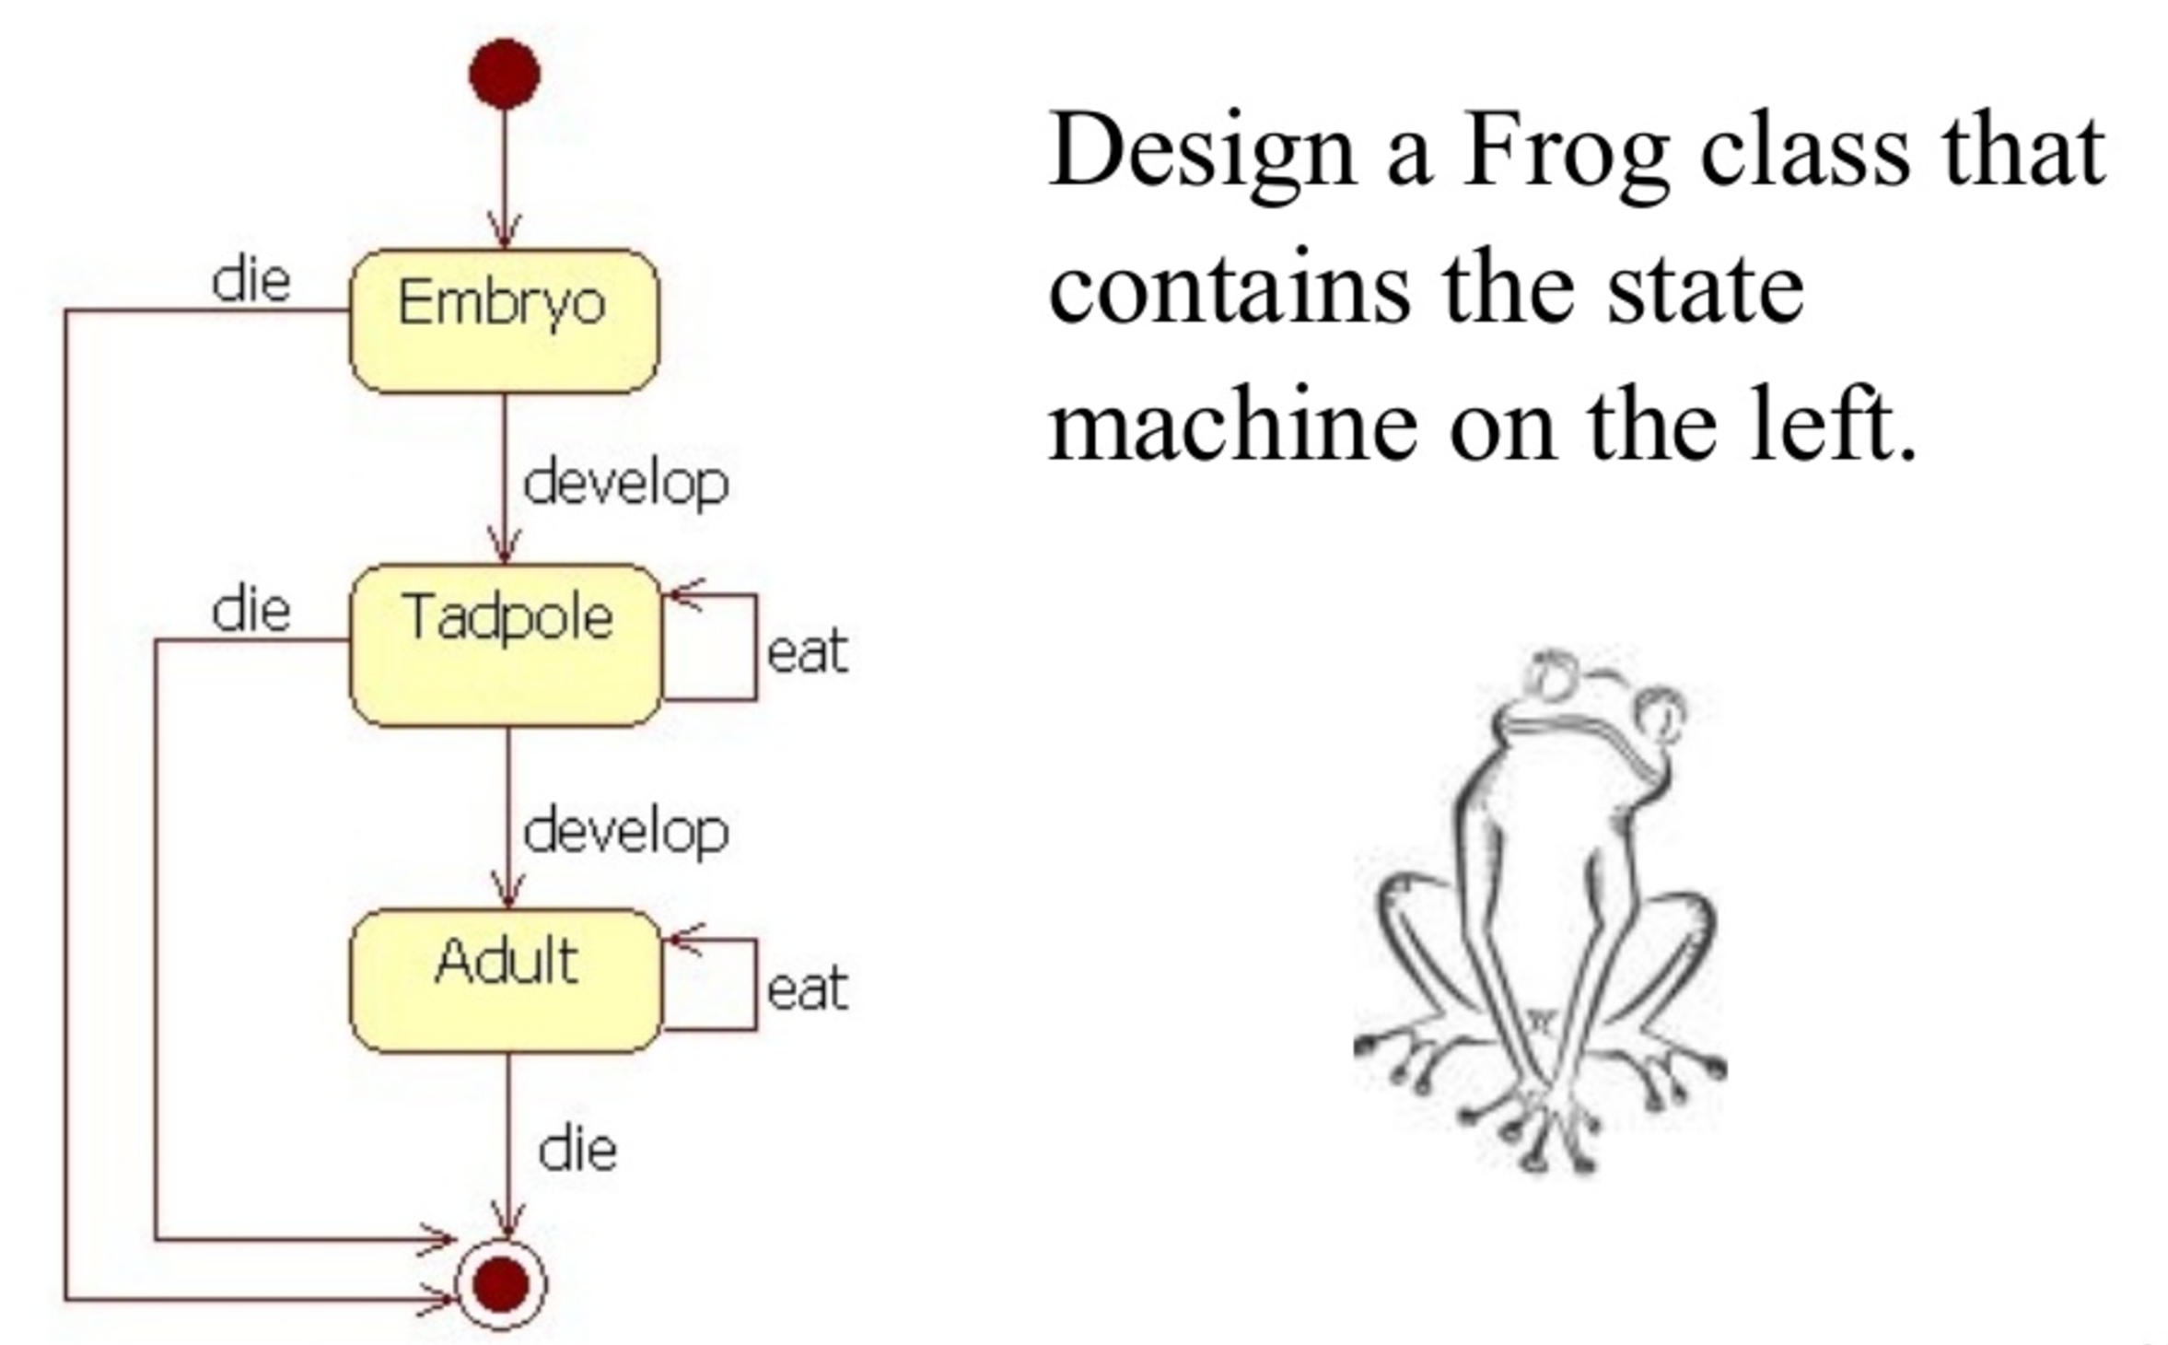
Exercise

Slide 16
Advantages
Localizes all behaviour associated with a particular state into one object
New states and transitions can be added easily by defining new subclasses
Makes the state transitions explicit
Simplifies maintenance
Disadvantages
If the system has many states, the number of classes will grow

Slide 17
State vs Strategy (Recall the History)
In state, the Context contains state as instance variable, whereas, in strategy, strategy is passed as argument to the method and context object doesn’t have any variable to store it.
With Strategy, the choice of algorithm is fairly stable. With State, a change in the state of the Context object causes it to select from its "palette" of Strategy objects.

Slide 18

Thank You

